Slide 1

Customer Shopping Behavior Analysis
Uncovering insights from transactional data to guide strategic business decisions.

Slide 2

Project Overview
Goal
Focus Areas
Analyze 3,900 purchases for insights.
Spending patterns, segments, product preferences, subscriptions.
Outcome
Guide strategic business decisions.

Slide 3

Dataset Summary
Data Volume
3,900 rows, 18 columns.
Key Features
Demographics, purchase details, shopping behavior.
Missing Data
37 values in Review Rating.

Slide 4
Exploratory Data Analysis: Python
01
02
03
Data Loading & Exploration
Data Cleaning
Standardization
Pandas for import, `df.info()`, `.describe()` for summary.
Imputed missing Review Ratings with median by category.
Renamed columns to snake_case.
04
05
Feature Engineering
Database Integration
Created `age_group` and `purchase_frequency_days`.
Loaded cleaned data to PostgreSQL for SQL analysis.

Slide 5
SQL Analysis: Key Business Questions
1
2
3
Revenue by Gender
High-Spending Discount Users
Top 5 Products by Rating
Female: $75,191, Male: $157,890.
Gloves (3.86), Sandals (3.84), Boots (3.82), Hat (3.80), Skirt (3.78).
Identified 839 customers.
4
5
Shipping Type Comparison
Subscribers vs. Non-Subscribers
Standard: $58.46, Express: $60.48.
Subscribers: 1,053, Avg Spend: $59.49. Non-Subscribers: 2,847, Avg Spend: $59.87.

Slide 6
SQL Analysis: Deeper Insights
1
2
3
Discount-Dependent Products
Customer Segmentation
Top 3 Products per Category
Loyal: 3,116, Returning: 701, New: 83.
Hat (50%), Sneakers (49.66%), Coat (49.07%), Sweater (48.17%), Pants (47.37%).
Jewelry, Blouse, Sandals, Jacket are top in their categories.
4
5
Repeat Buyers & Subscriptions
Revenue by Age Group
958 repeat buyers are subscribers, 2,518 are not.
Young Adult: $62,143, Middle-aged: $59,197, Adult: $55,978, Senior: $55,763.

Slide 7
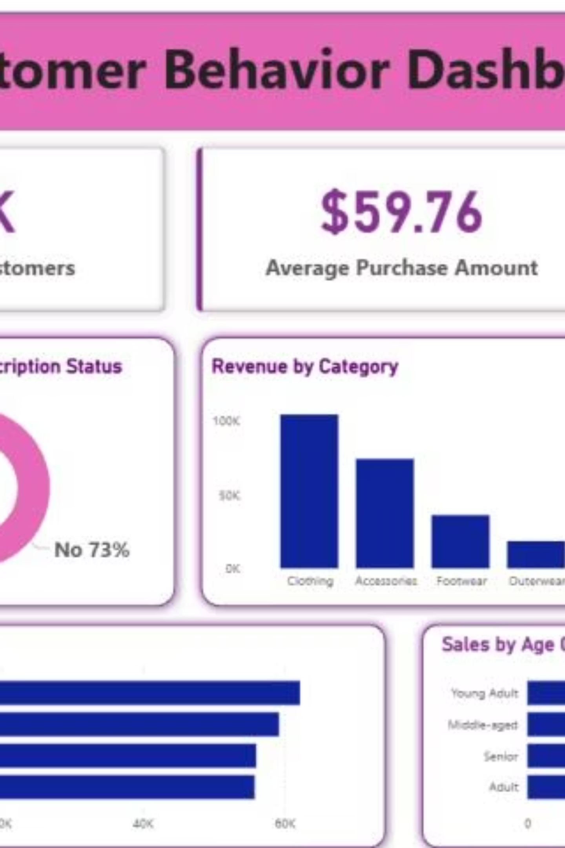
Customer Behavior Dashboard
Interactive Power BI dashboard for visual insights.

Slide 8
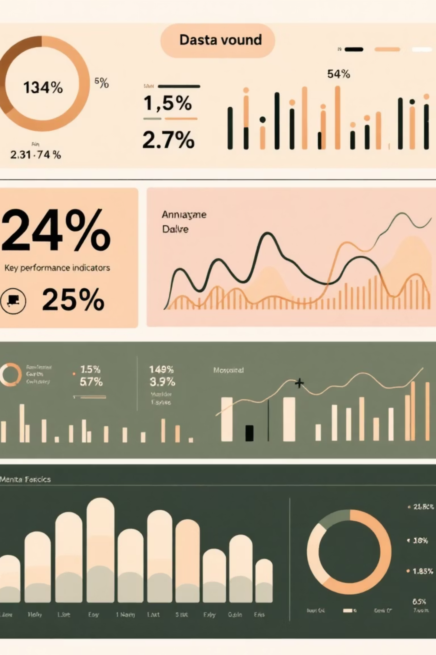
Key Metrics at a Glance
3.9K
$59.76
3.75
Customers
Avg. Purchase
Avg. Review

Slide 9
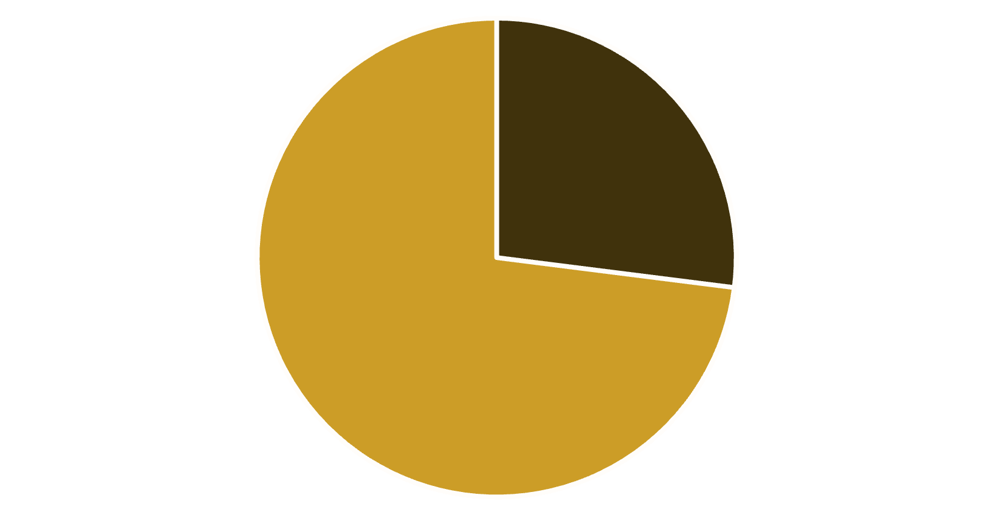
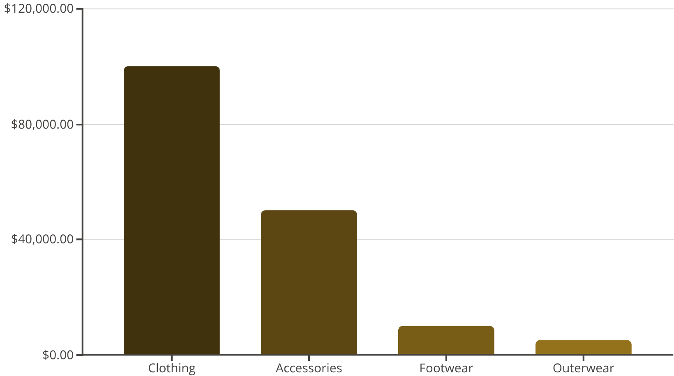
Subscription Status & Revenue
% of Customers by Subscription Status
Revenue by Category
Yes
No

Slide 10

Business Recommendations
Boost Subscriptions
Promote exclusive benefits.
Customer Loyalty Programs
Reward repeat buyers.
Review Discount Policy
Balance sales with margin control.
Product Positioning
Highlight top-rated and best-selling items.
Targeted Marketing
Focus on high-revenue age groups and express-shipping users.

